Slide 1
A Few Big Data Tools
(Rao)
CS5540

Slide 2
Agenda
Apache Hadoop
Apache Pig
Apache HBase
IBM Jaql
Apache Hive
All of the above are part of IBM BigInsights/Hadoop distribution.
Other tools of interest
MongoDB, CouchDB, Tajo, Spark, Flink
Notes:
Talk a bit about NoSQL

Slide 3
Hadoop Distributed File System (HDFS)
http://hadoop.apache.org
hadoop fs […….]
Examples
hadoop fs [-help [cmd]]
hadoop fs [-ls <path>]
hadoop fs [-lsr <path>]
hadoop fs [-du <path>]
hadoop fs [-cat <src>]
hadoop fs [-mv <src> <dst>]
hadoop fs [-cp <src> <dst>]
hadoop fs [-mkdir <path>]
hadoop fs [-touchz <path>]
Notes:
hdfs dfs [] [] can be used if you want to refer to just HDFS
Hadoop fs refers to both local and HDFS
hadoop fs –getmerge -- merge all the file

Slide 4
Commands in HDFS
Examples
hadoop fs [-rm <path>]
hadoop fs [-rmr <path>]
hadoop fs [-copyFromLocal <localsrc> ... <dst>]
hadoop fs [-moveFromLocal <localsrc> ... <dst>]
hadoop fs [-copyToLocal <src> <localdst>]
hadoop fs [-moveToLocal <src> <localdst>] // not implemented yet?
hadoop fs [-stat <path>]
hadoop fs [-tail <file>]
hadoop fs [-chmod <MODE[,MODE]... | OCTALMODE> PATH...]
hadoop fs -setrep // change replication factor
hadoop fs –put <src> <dst> // copy multiple files to HDFS
hadoop fs –get <src> <dst> // copy multiple files from HDFS
Notes:
-stat → meta data of the file like owner, size, replication factor etc.

Slide 5
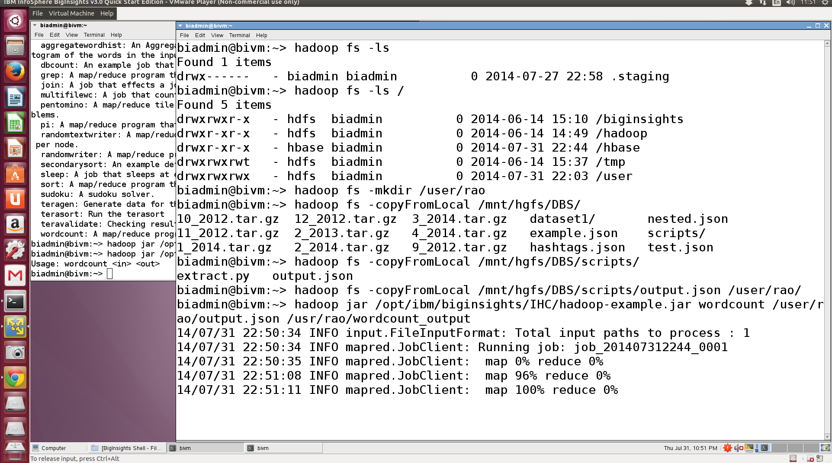
Examples
Notes:
Explain word count program

Slide 6
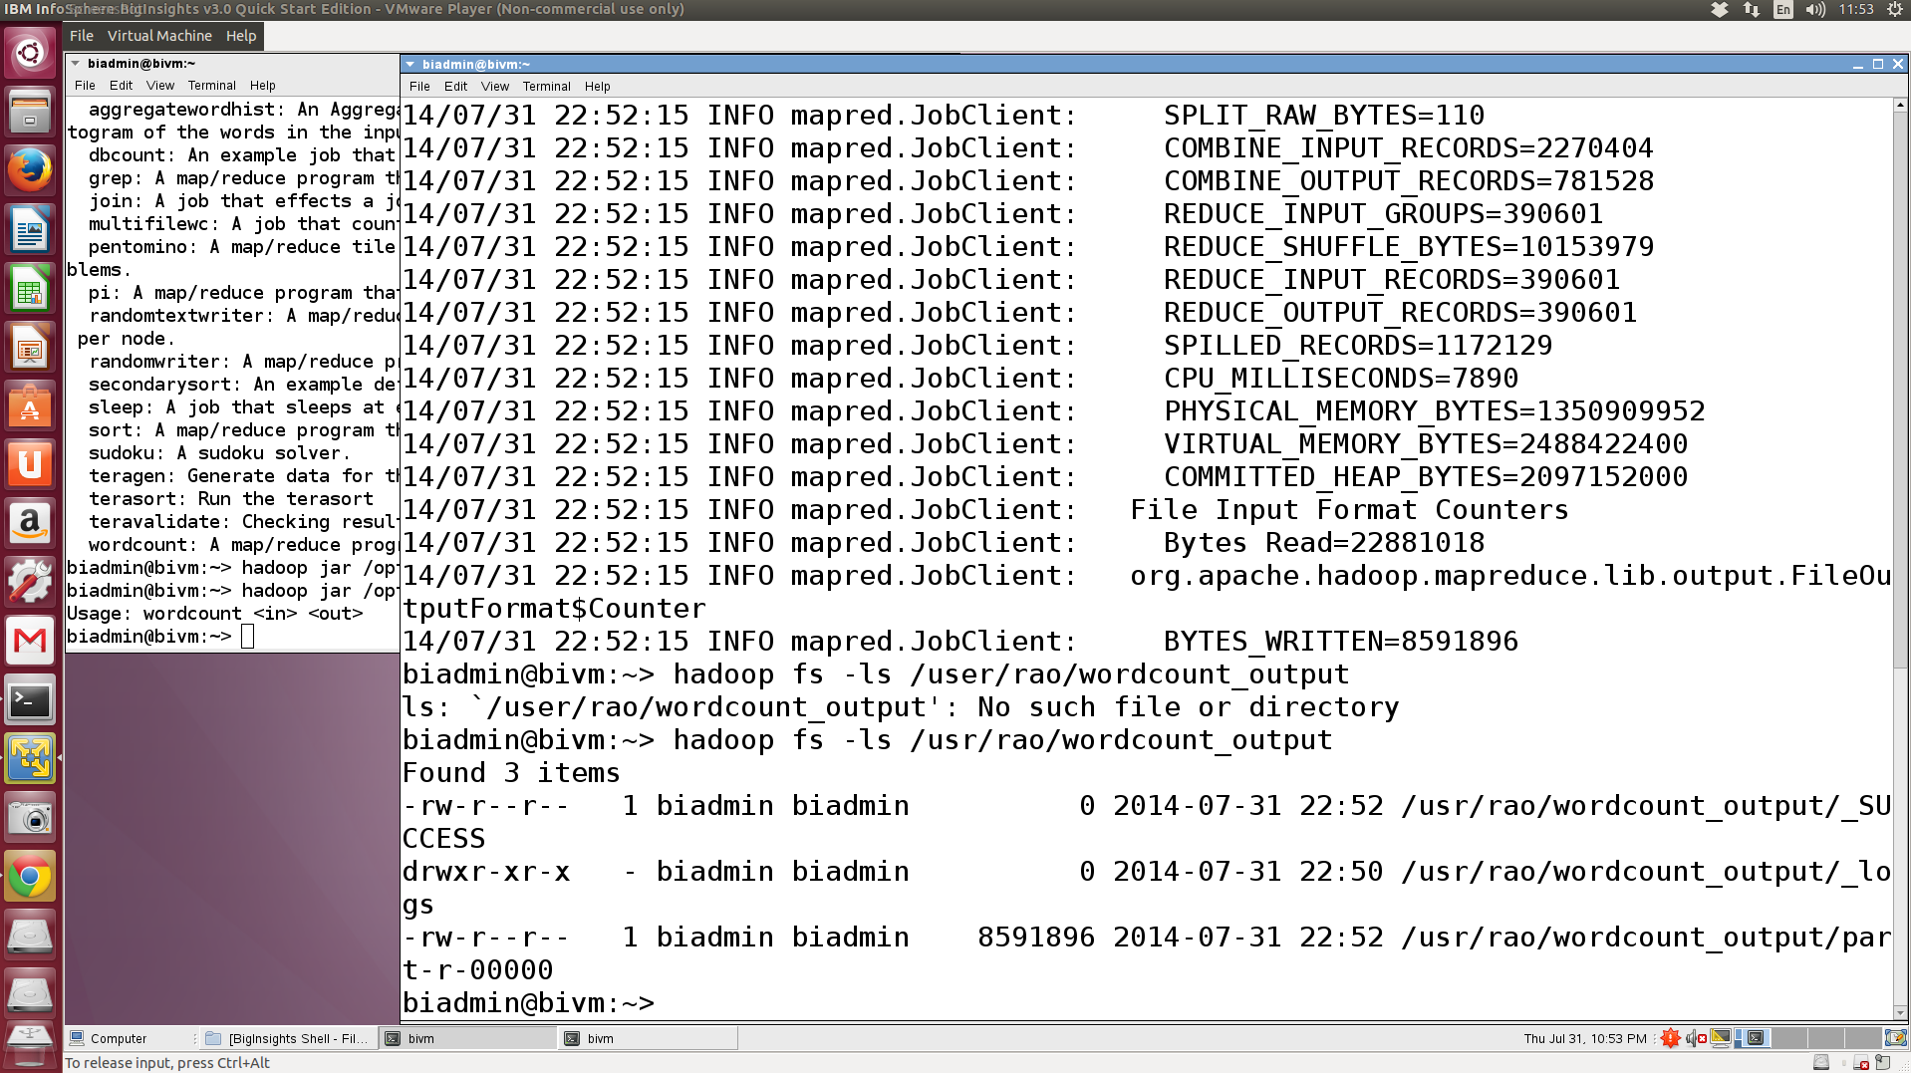
Examples

Slide 7
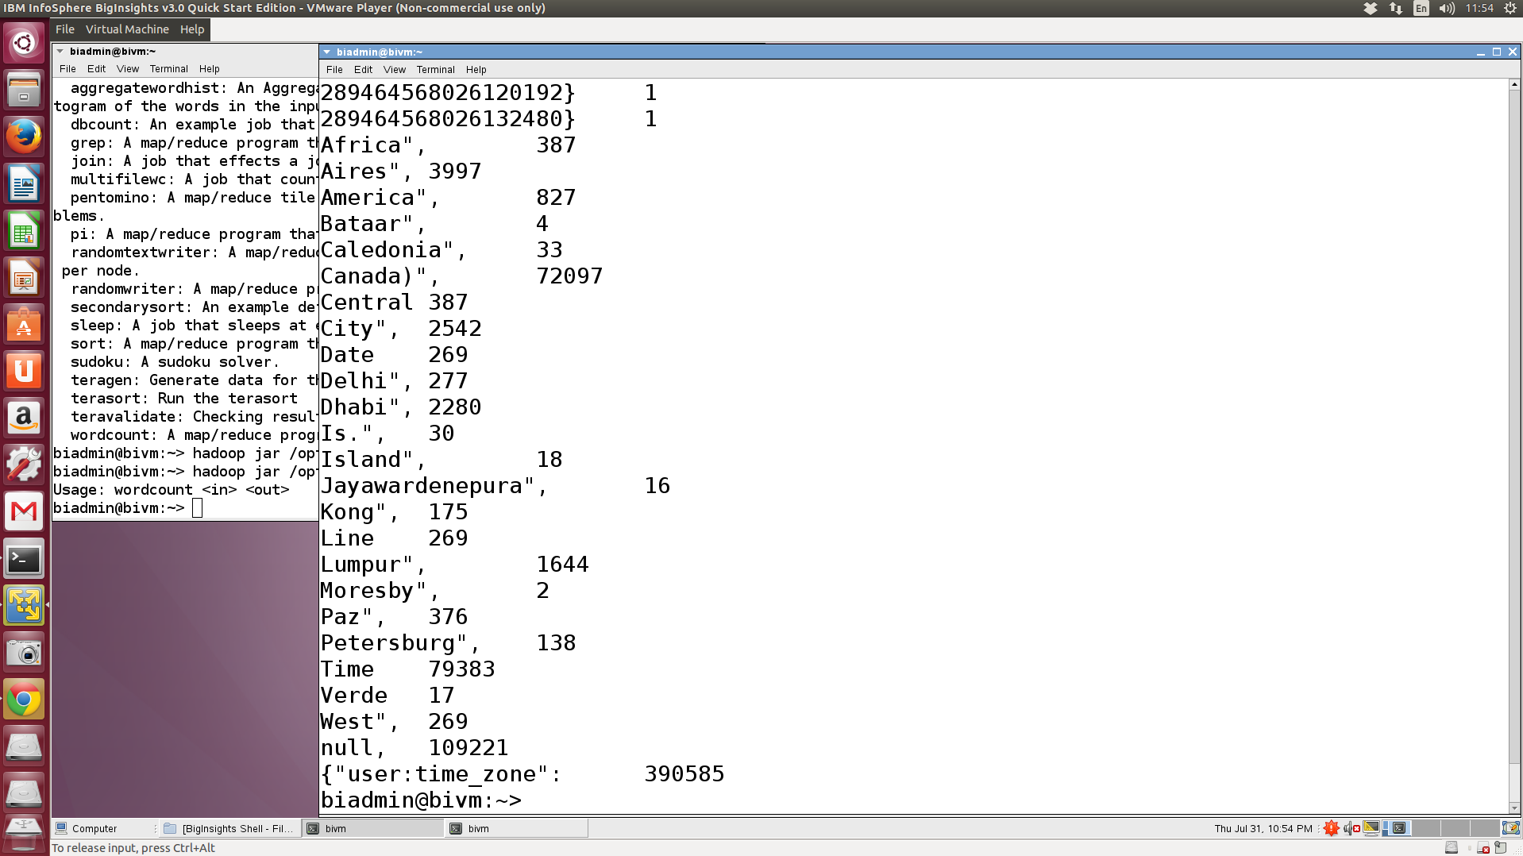

Examples
output of Word Count program

Slide 8
Apache Pig
An open-source tool for data analysis on large datasets
http://pig.apache.org
Developed by engineers at Yahoo!
Pig runs on top of Hadoop
Pig accesses files from HDFS (and not from local file system)
Pig
Hadoop
OS

Slide 9
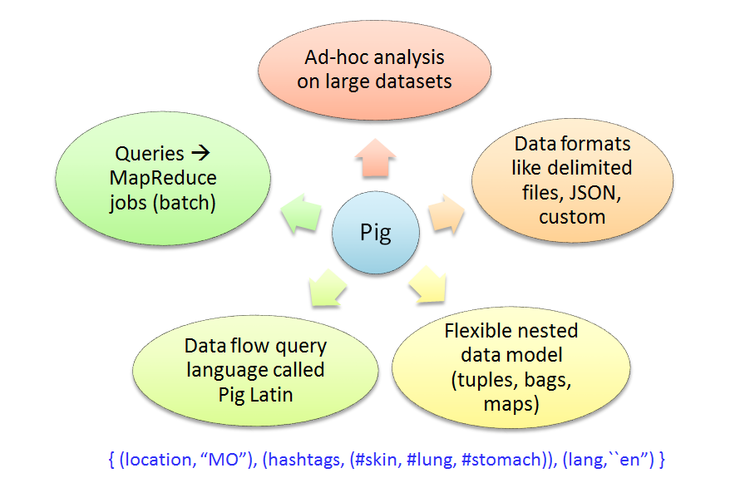
Pig
Notes:
Tuple – ordered set of fields/values (1, 2, 3)
Bag – unordered collection of tuples
Map – a set of key-value pairs → [k1#v1, k2#v2]

Slide 10
Basic Commands
To start the Pig shell type pig in the terminal
To load a file into a logical table
Type the following command in the Pig shell
grunt> A = load ‘raopr/Subway_Entrances.csv’ using PigStorage(‘,’);
Creates a logical table A
$0 | $1 | $2 | $3 | $4 | $5
.. | .. | .. | .. | .. | ..
1896 | 40.74531233400006 | 73.98895400099991 | Broadway & 28th St At Sw Corner (Downtown Only) | http://www.mta.info/nyct/service/ | N-R

Slide 11
Basic Commands
To load a file into a logical table and assign names to the columns
Type the following command in the Pig shell
grunt> B = load 'raopr/Subway_Entrances.csv' using PigStorage(',') as (id, lat, lon, address, url, code);
Creates a logical table B
id | lat | lon | address | url | code
.. | .. | .. | .. | .. | ..
1896 | 40.74531233400006 | 73.98895400099991 | Broadway & 28th St At Sw Corner (Downtown Only) | http://www.mta.info/nyct/service/ | N-R

Slide 12
Basic Commands
To display a table on screen, use the dump command
To store a table in HDFS; output is stored in the given directory (in pieces)
grunt> dump A;
grunt> dump B;
grunt> store A into ’raopr/outA’
grunt> store A into ’raopr/outB’

Slide 13
Basic Commands
To select a few columns in a table
To select a subset of rows in a table
grunt> C = foreach A generate $0, $2, $3;
grunt> dump C;
grunt> D = foreach B generate id, lon, address;
grunt> dump D;
grunt> E = filter A by $0 == '1898' or $5 == '4-6-6 Express';
grunt> dump E;
grunt> F = filter B by id != ’1898’;
grunt> dump F;

Slide 14
Basic Commands
To join two logical tables
To order the results
grunt> Z = join X by id, Y by id;
grunt> dump Z;
grunt> U = order X by $1;
grunt> dump U;

Slide 15
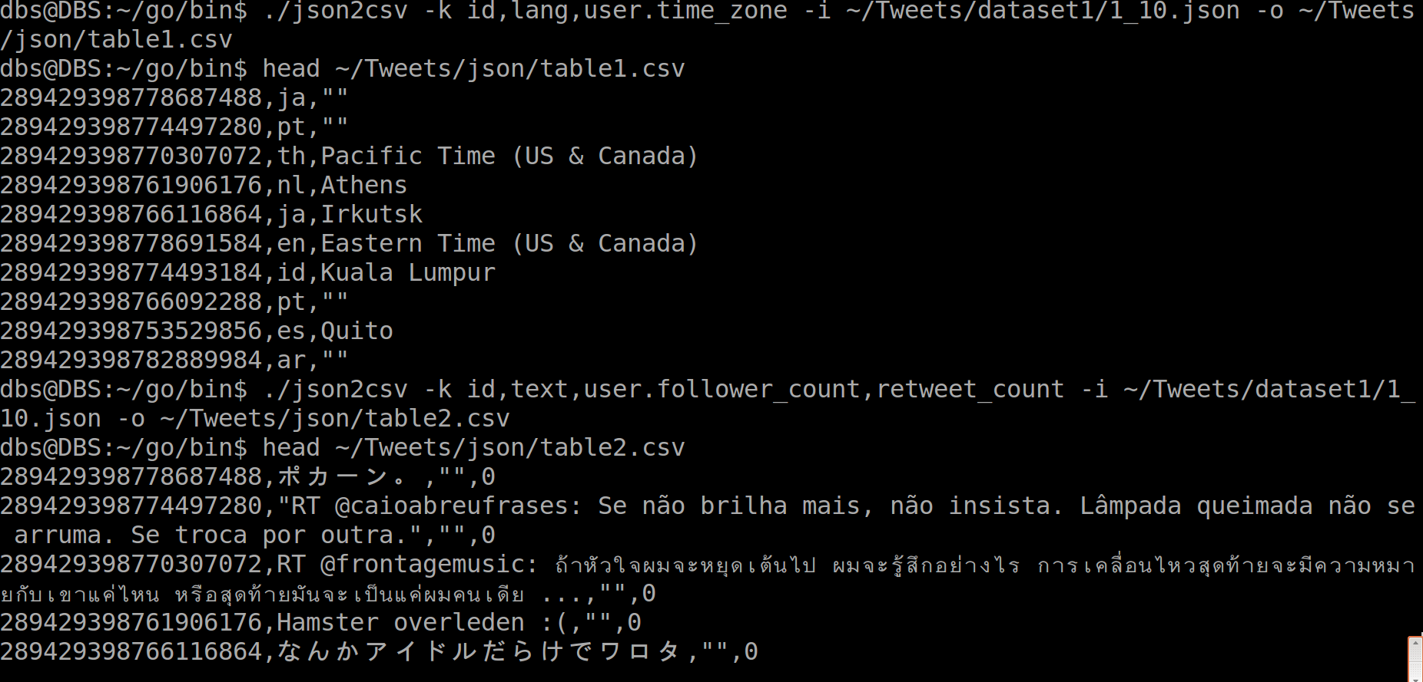
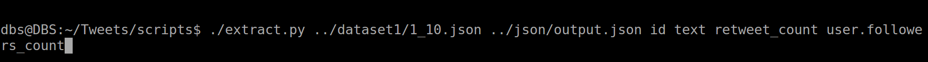
Examples
https://github.com/jehiah/json2csv
https://github.com/raopr/twitter-project.git

Slide 16
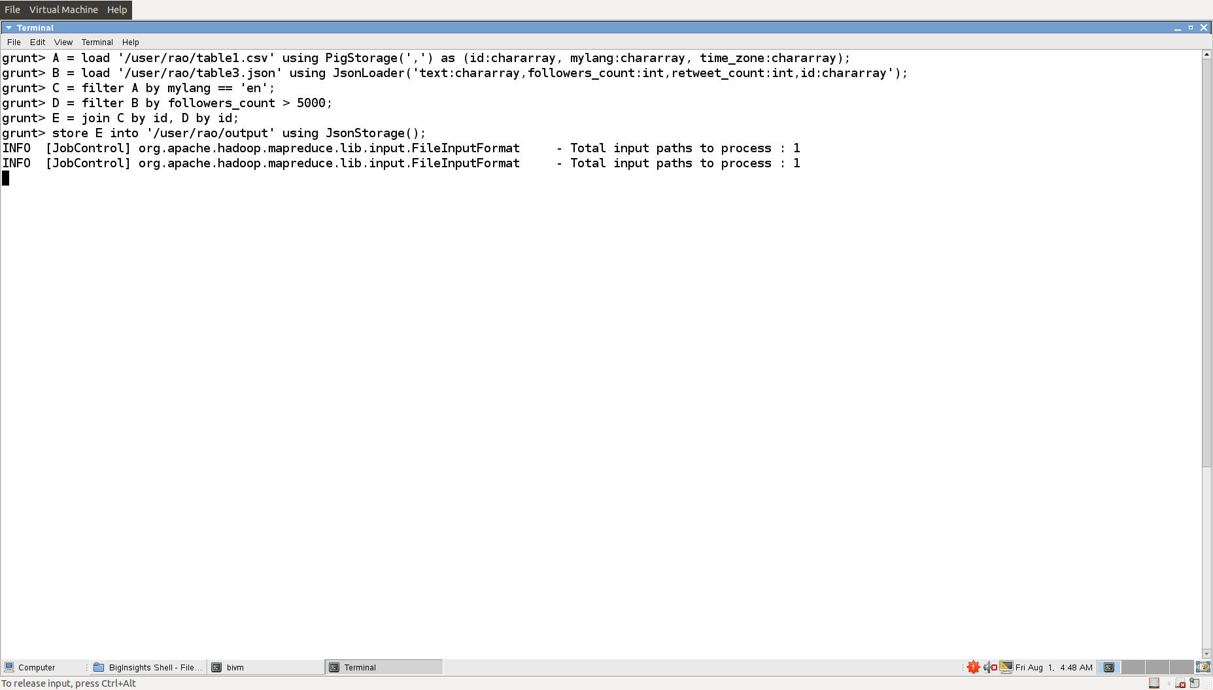
Example: Join
id | mylang | time_zone
text | followers_count | retweet_count | id
Join
Notes:
Pig fields default to bytearray if type is not mentioned

Slide 17
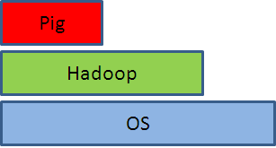
Apache HBase
HBase is an open-source project and is based on Google’s BigTable
http://hbase.apache.org
Used in Big Data applications where there is a need to manage very large tables with billions of rows and millions of columns
Cluster of machines
Random reads/writes
HBase

Slide 18
HBase
HBase
Random fast reads and writes; inspired by BigTable
Data formats like delimited files, custom
Billions of rows and millions of columns; flexible schema
Query language: get, put, scan, etc.; no support for joins
Real-time access (e.g. metadata)

Slide 19
Data Model
rowkey | timestamp | ColumnFamily meta | ColumnFamily content
www.bbc.co.uk | t2 | meta:creator=“johndoe”
www.bbc.co.uk | t3 | meta:location=“london”
www.cnn.com | t9 |  | content:info=“royals”
www.cnn.com | t7 |  | content:info=“hello world”
Rows are sorted by rowkey
We refer to attributes using the ColumnFamily name as the prefix
- E.g., meta:creator, content:info
Notes:
Storing sparse tables – denormalized form – unlike RDBMS, so no joins are really needed! Important.

Slide 20
Another View
rowkey | TS | columnfamily_1 |  | columnfamily_2
 |  | attr1 | attr2 | attr3 | Attr4
123456790 |  | NULL | …. | …. | ….
123456791 |  | …. | NULL | NULL | ….
123456792 |  | …. | …. | …. | ….
123456793 |  | NULL | NULL | …. | ….
123456794 |  | …. | …. | …. | NULL
Sparse table
Notes:
Table is partitioned into regions based on rowkey
There is a master and region servers
Each region is managed by a region server; a region server can manage multiple regions; each column family is store separately in the region server; memory table + disk file

Slide 21
Basic Commands
To start HBase, type hbase shell
To create a table with name webtable and two column families meta and content
To delete a table (first disable it)
hbase(main):001:0> create 'webtable', 'meta', 'content'
hbase(main):005:0> disable 'webtable'
hbase(main):006:0> drop 'webtable'

Slide 22
Basic Commands
Insert a row with rowkey www.bbc.co.uk and value abc for attribute creator in ColumnFamily meta
Insert using the same rowkey and value 123 for attribute location in meta
The system picks a timestamp if not specified
hbase(main):009:0> put 'webtable', 'www.bbc.co.uk', 'meta:creator', 'abc'
0 row(s) in 0.1410 seconds
hbase(main):010:0> put 'webtable', 'www.bbc.co.uk', 'meta:location', '123'
0 row(s) in 0.0080 seconds

Slide 23
Basic Commands
Print a table
hbase(main):011:0> scan 'webtable'
ROW COLUMN+CELL
www.bbc.co.uk column=meta:creator, timestamp=1372698985649, value=abc
www.bbc.co.uk column=meta:location, timestamp=1372698995764, value=123
1 row(s) in 0.0270 seconds

Slide 24
Assignment
Create the below table using HBase
people
rowkey | TS | courses |  | hobby
 |  | CS | ECE | soccer | baseball
John |  | cs490
Mary |  |  |  |  | yes
Bob |  |  | ece210
Alice |  |  |  | yes
Mike |  |  |  |  | yes
Jill |  |  |  | no
Notes:
create ‘people’ , ‘courses:CS’, ‘courses:ECE’, ‘hobby:soccer’, ‘hobby:baseball’
put ‘people’, ‘John’, ‘courses:CS’, ‘cs490’

Slide 25
Basic Commands
To get a row or cell contents
To delete a row or cell contents
If a file contains HBase commands, you can run it
hbase(main):012:0> get 'webtable', 'www.bbc.co.uk'
hbase(main):013:0> get 'webtable', 'www.bbc.co.uk', 'meta:location'
hbase(main):014:0> deleteall 'webtable', 'www.bbc.co.uk'
hbase(main):015:0> delete 'webtable', 'www.bbc.co.uk', 'meta:location'
hbase shell < filename

Slide 26
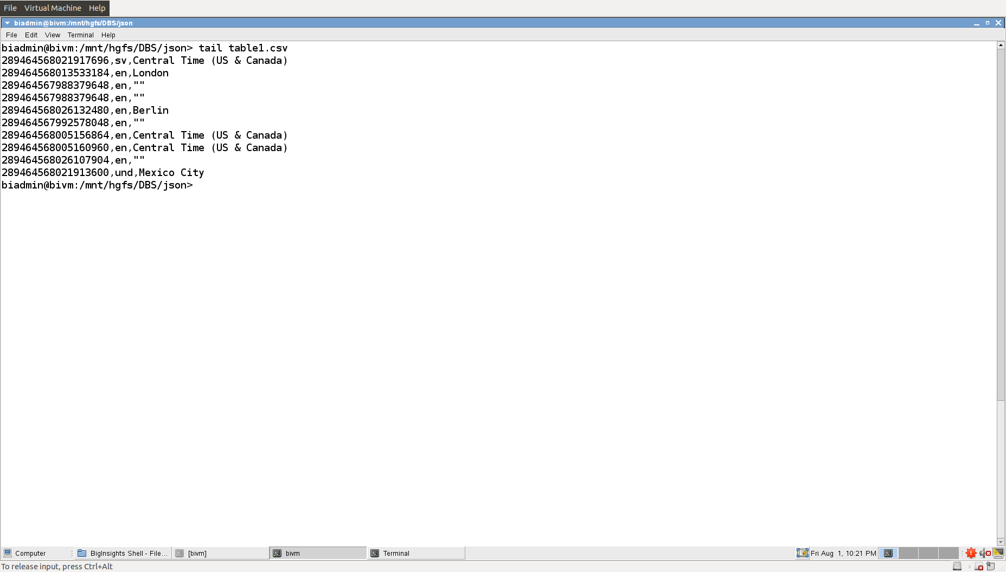
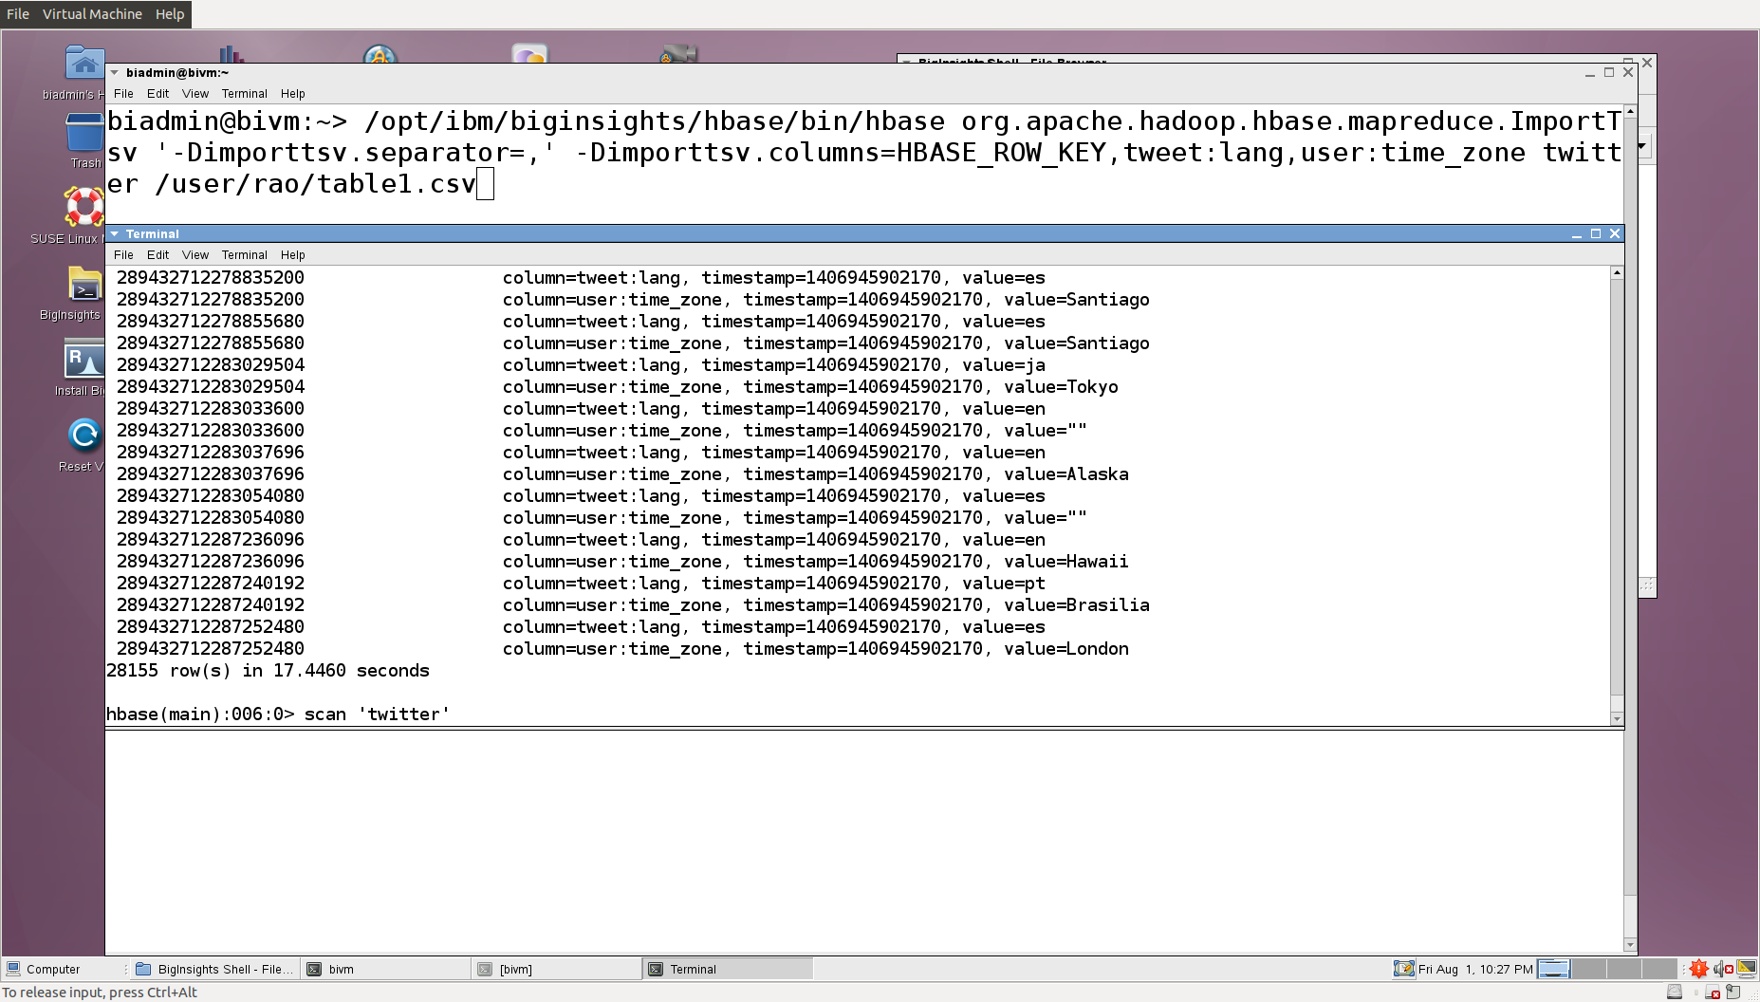
Examples
Input CSV file
Bulk loading

Slide 27
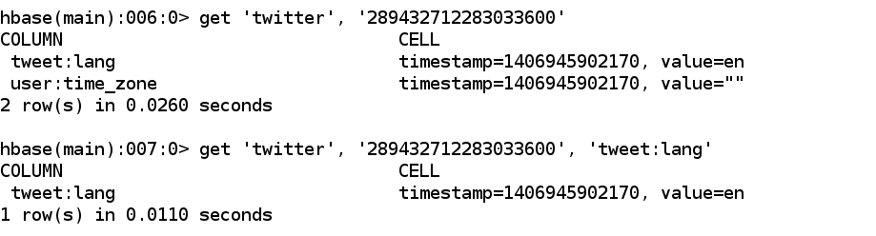
Examples
Retrieve a particular rowkey and column attribute

Slide 28
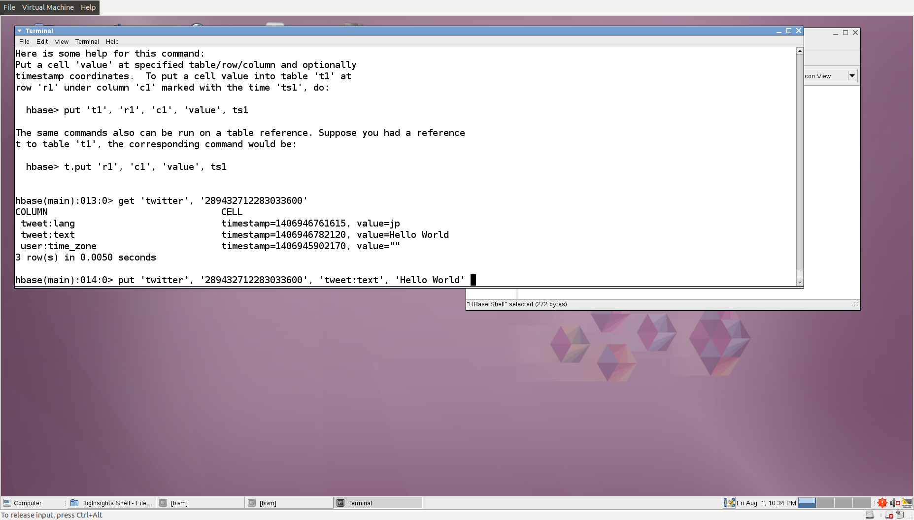
Examples
Insert a new column attribute for a rowkey

Slide 29
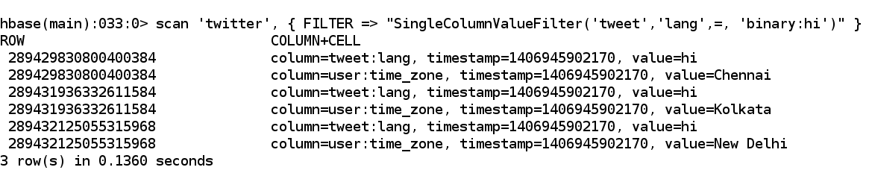
Examples
Selection

Slide 30
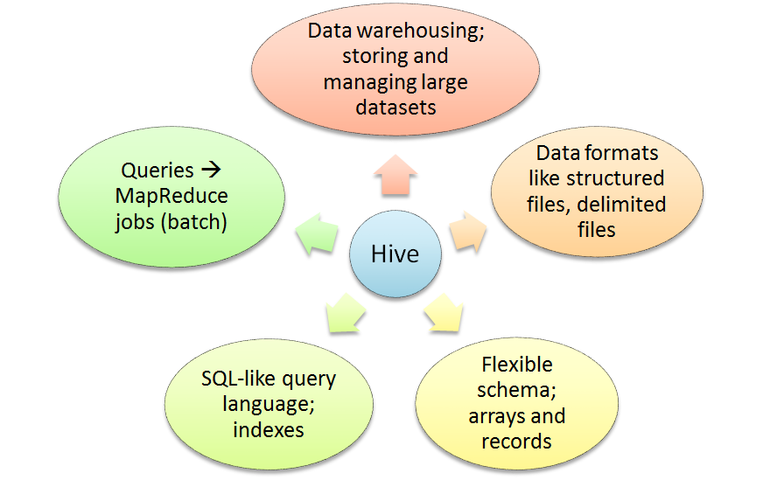
Apache Hive

Slide 31
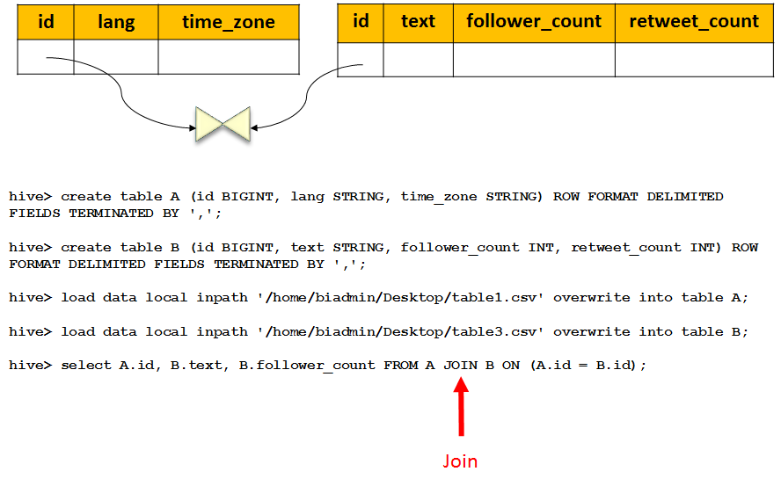
Examples
Notes:
Arrays, records, and Map – different from RDBMS

Slide 32
IBM Jaql
A query language for JSON
JSON records (name/value pairs), arrays
Can do selections, joins, group by, etc.

Slide 33
IBM Jaql
Jaql
Processing massive datasets (JSON, semistructured)
Data formats like delimited files, JSON, XML, custom
Data model supports arrays and records; flexible schema
Query language is inspired by SQL, XQuery, Pig, Lisp
Queries → MapReduce jobs (batch)
[ {“location”: “MO”, “hashtags”: [“#skin”, “#lung”, “#stomach”], “lang”: “en”}, {…}, … ]

Slide 34
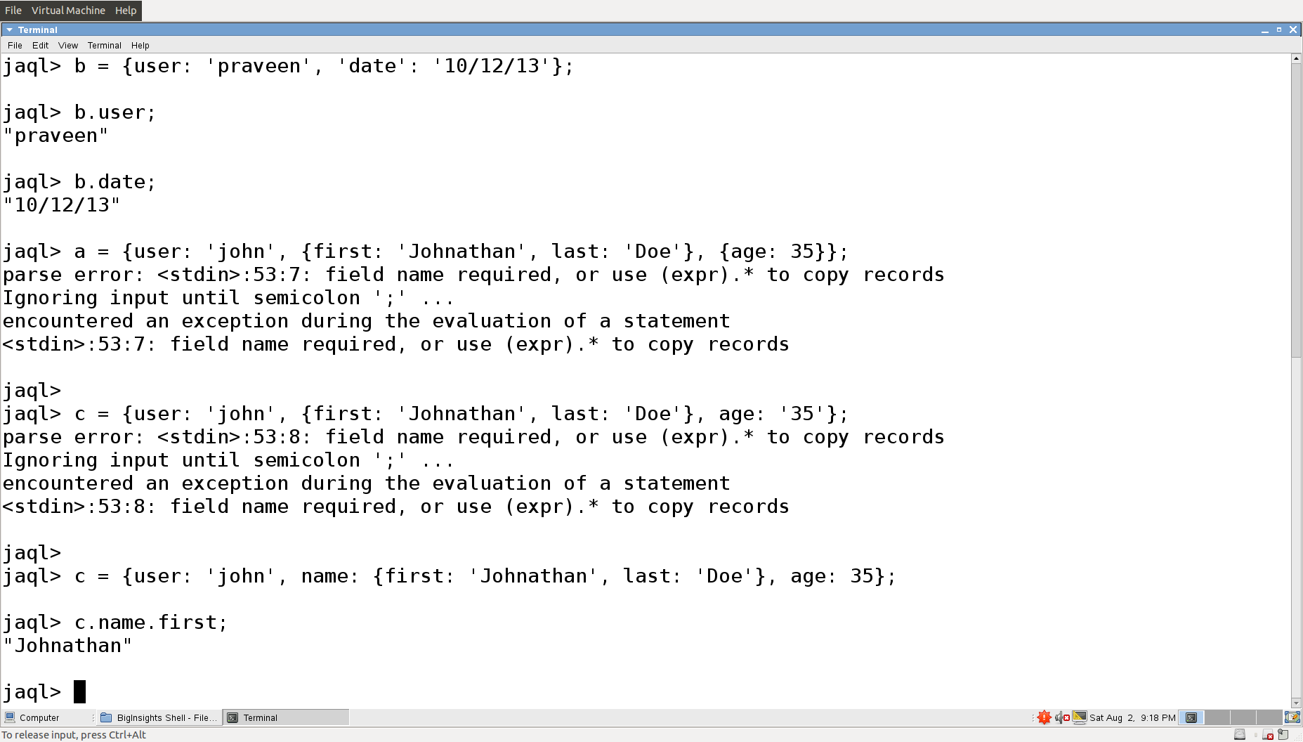
Examples
Record
Record with nesting
Like a path expression

Slide 35
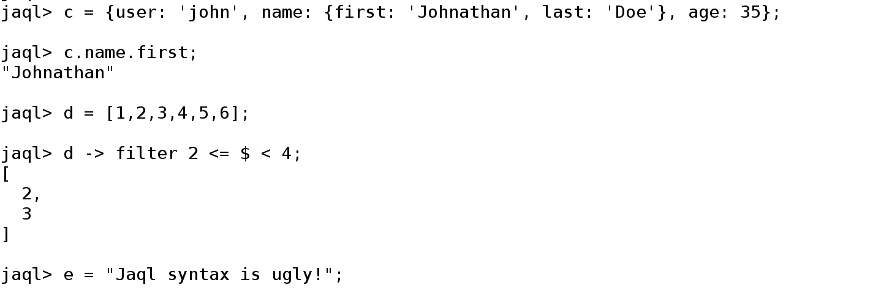
Examples
Array
Filter each array element ($) using a predicate
Indicates flow of data
You may agree!

Slide 36
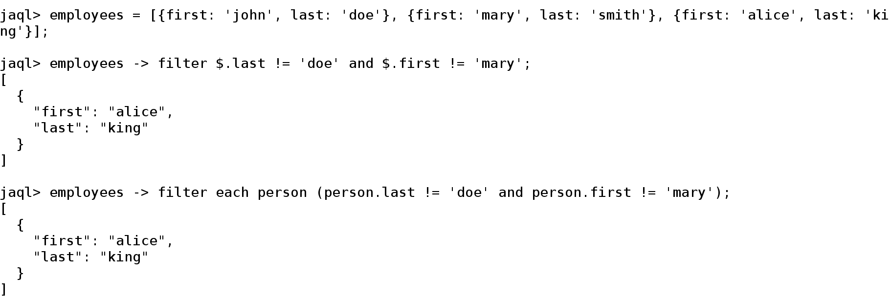
Examples
Filter each record ($) using a predicate
Another syntax in place of $

Slide 37
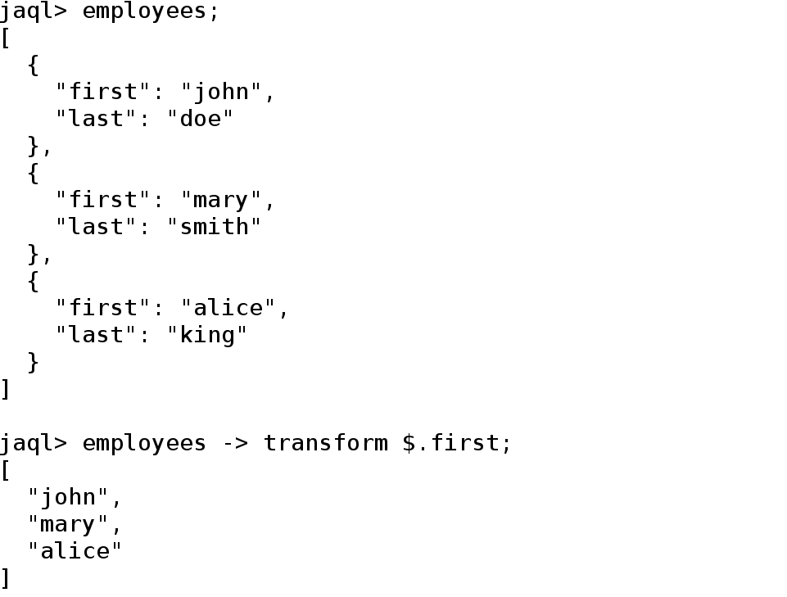
Examples
Extract data

Slide 38
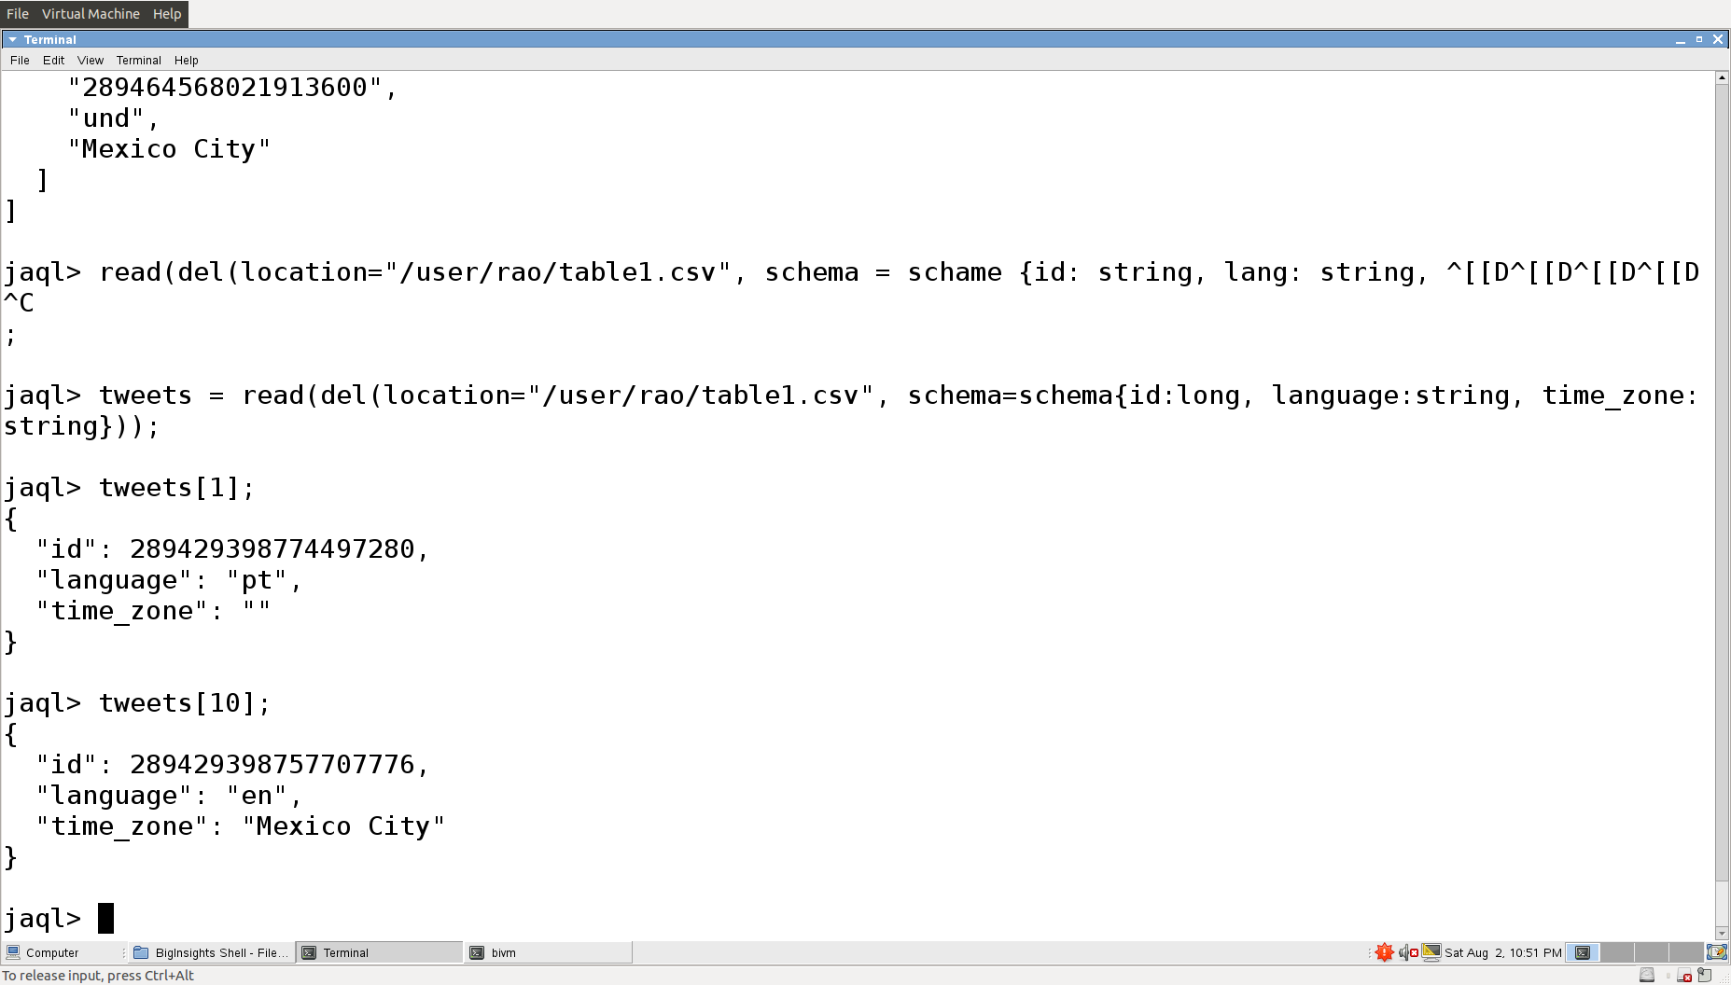
Examples
Bulk loading
Schema

Slide 39
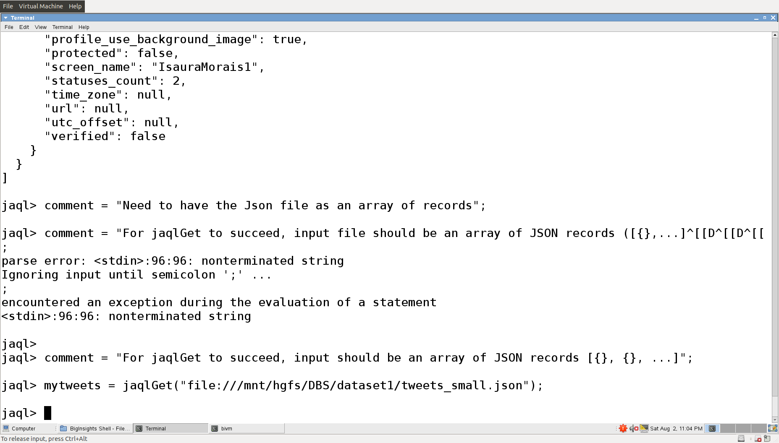
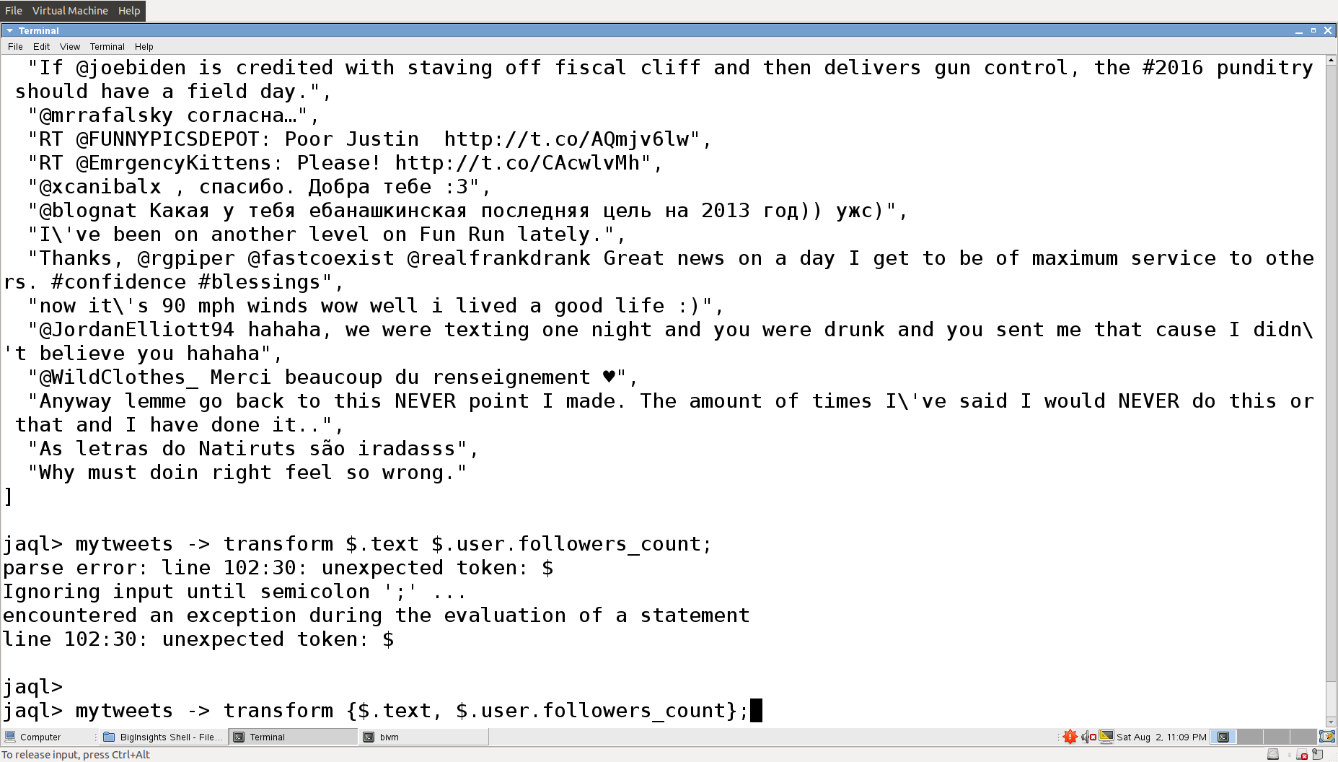
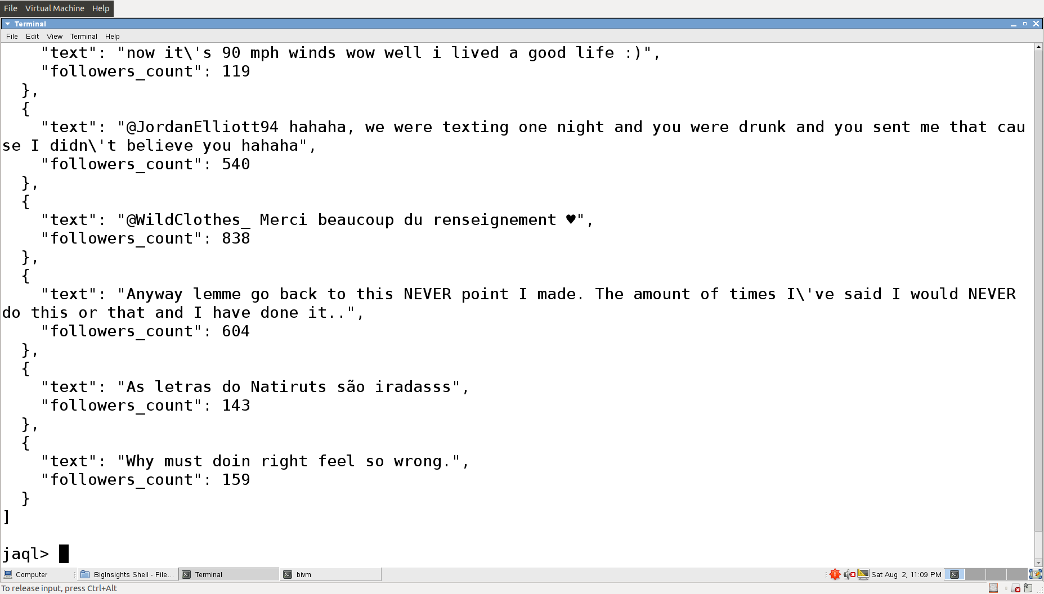
Examples
Output
Bulk loading

Slide 40
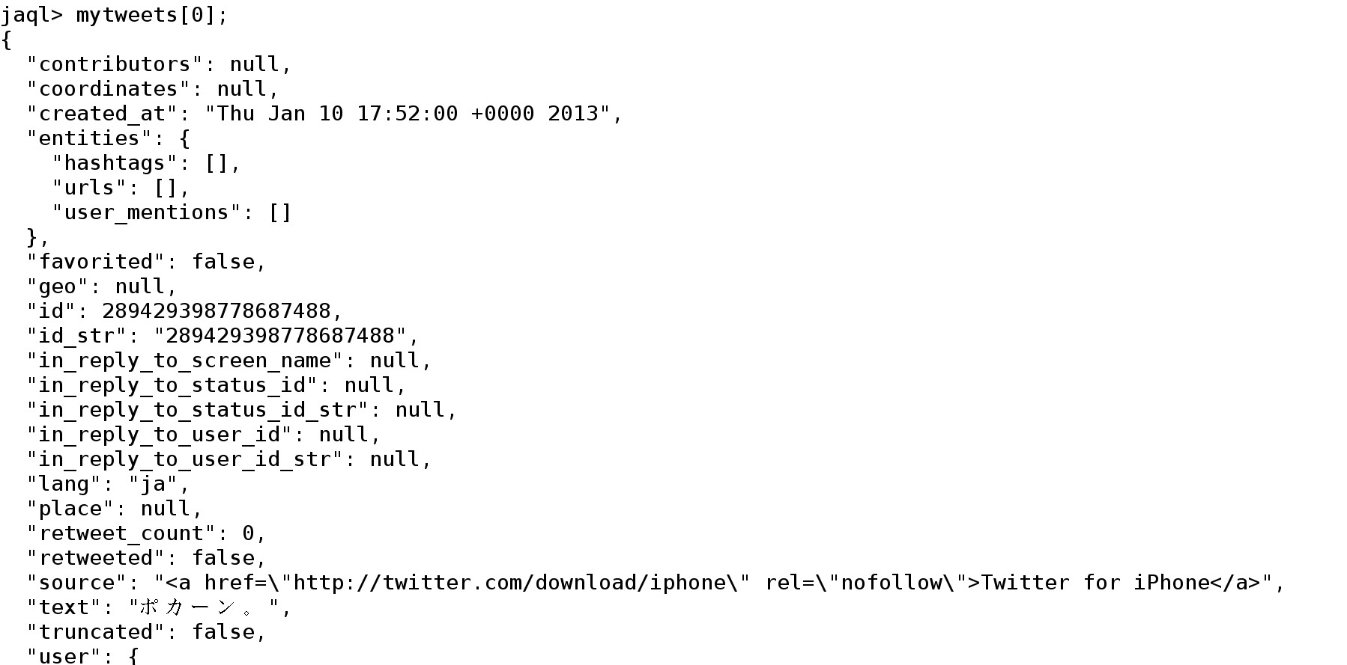
Examples

Slide 41
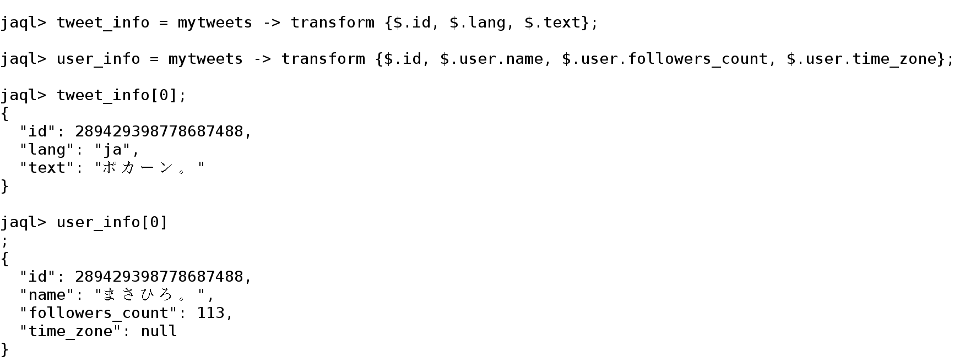
Examples
Let’s split a tweet into two pieces
Let’s do a join on user_info and tweet_info

Slide 42
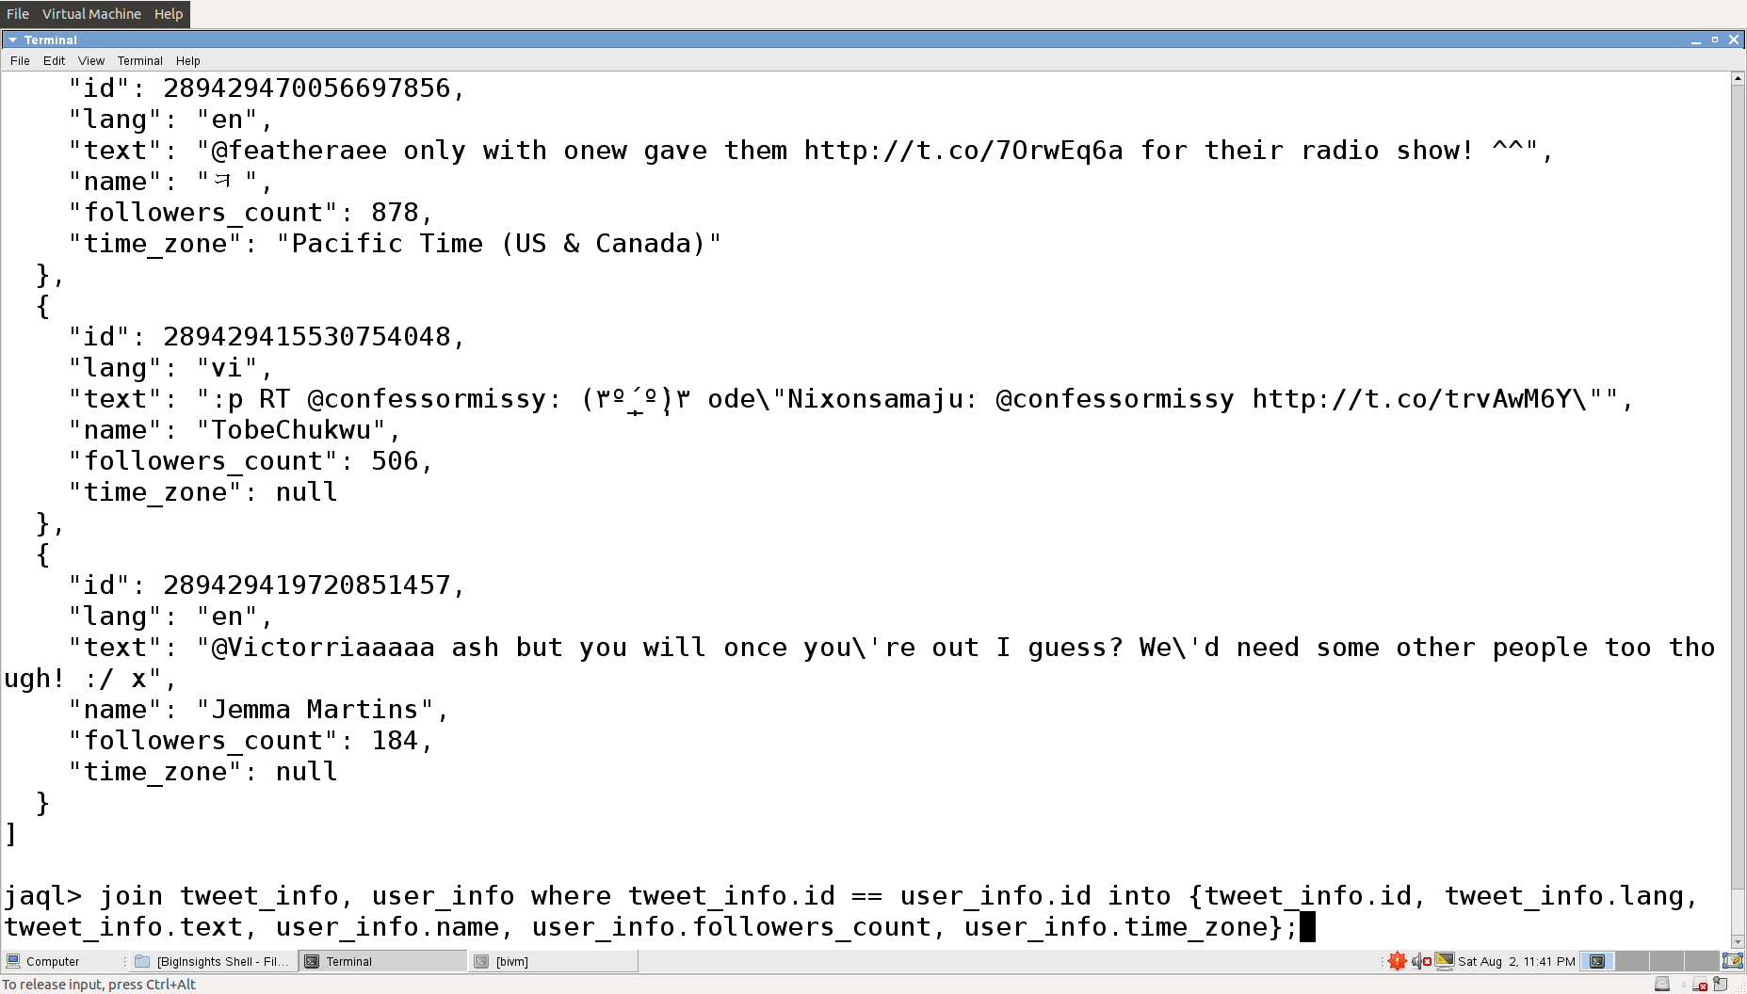
Examples
Join condition
Projection
Output

Slide 43
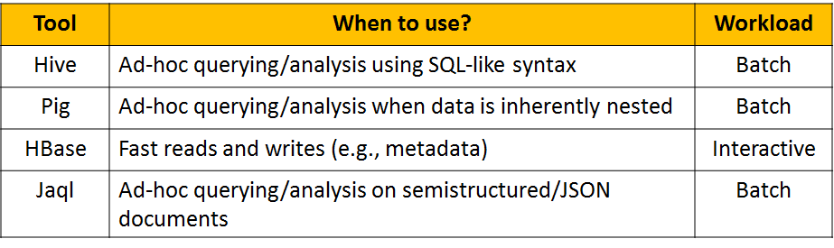
Summary

